Slide 1
Introduction to Algorithms
Notes:
*

Slide 2
Analogy
An algorithm is like a recipe.
Notes:
*

Slide 3
Analogy
An algorithm is like a recipe.
To make a tossed salad:
• Mix together vegetables of your choice.
• Add 2 parts olive oil to 1 part vinegar.
• Add salt and pepper to taste.
• Toss well.
• Serve immediately.
Notes:
*

Slide 4
Analogy
An algorithm is like a recipe.
To make a tossed salad:
• Mix together vegetables of your choice.
• Add 2 parts olive oil to 1 part vinegar.
• Add salt and pepper to taste.
• Toss well.
• Serve immediately.
The Difference:
Computer algorithms are more precise.
Notes:
*

Slide 5
Definition
An algorithm is a step-by-step procedure that does some calculation or computation.
Notes:
*

Slide 6
Definition
An algorithm is a step-by-step procedure that does some calculation or computation.
Each step in the algorithm must be precise and unambiguous.
Notes:
*

Slide 7
Definition
An algorithm is a step-by-step procedure that does some calculation or computation.
Each step in the algorithm must be precise and unambiguous.
Each step must be doable – i.e., it can't be something that is impossible to do.
Notes:
*

Slide 8
Simple Example
To: calculate the average of 3 numbers on paper.
Paper
Notes:
*

Slide 9
Simple Example
To: calculate the average of 3 numbers on paper.
1. Write the first number on a piece of paper.
Paper
9
Notes:
*

Slide 10
Simple Example
To: calculate the average of 3 numbers on paper.
1. Write the first number on a piece of paper.
2. Add the second number to the first number.
Paper
9
6
15
Notes:
*

Slide 11
Simple Example
To: calculate the average of 3 numbers on paper.
1. Write the first number on a piece of paper.
2. Add the second number to the first number.
3. Add the third number to the sum of the first two numbers giving a new sum.
Paper
9
+ 6
15
+3
18
Notes:
*

Slide 12
Simple Example
To: calculate the average of 3 numbers on paper.
1. Write the first number on a piece of paper.
2. Add the second number to the first number.
3. Add the third number to the sum of the first two numbers giving a new sum.
4. Divide the sum of the three numbers by 3.
Paper
9
+ 6
15
+3
18 / 3
6
Notes:
*

Slide 13
Simple Example
To: calculate the average of 3 numbers on paper.
1. Write the first number on a piece of paper.
2. Add the second number to the first number.
3. Add the third number to the sum of the first two numbers giving a new sum.
4. Divide the sum of the three numbers by 3.
5. The resulting value is the average of the 3 numbers.
Paper
9
+ 6
15
+3
18 / 3
6
Notes:
*

Slide 14
What's Wrong with This Example?
To: wash your hair
1. Wash with the shampoo.
2. Rinse.
3. Repeat.
Notes:
*

Slide 15
What's Wrong with This Example?
To: wash your hair
1. Wash with the shampoo.
2. Rinse.
3. Repeat.
Answer: It is not precise enough. How many times should it be repeated? Twice? Until the bottle is empty? Forever?
Notes:
*

Slide 16
This algorithm is funny!
The programmer's spouse says: "Run to the store and pick up a loaf of bread. If they have eggs, get a dozen."
Notes:
*

Slide 17
This algorithm is funny!
The programmer's spouse says: "Run to the store and pick up a loaf of bread. If they have eggs, get a dozen."
The programmer comes home with 12 loaves of bread.
Notes:
*

Slide 18
This algorithm is funny!
The programmer's spouse says: "Run to the store and pick up a loaf of bread. If they have eggs, get a dozen."
The programmer comes home with 12 loaves of bread.
Problem: Ambiguous. Right? Get a dozen what?
Notes:
*

Slide 19
Another funny one!
A programmer's husband sends her to the store and says "get some bread, and while you're there pick up some eggs".
Notes:
*

Slide 20
Another funny one!
A programmer's husband sends her to the store and says "get some bread, and while you're there pick up some eggs".
The programmer never comes back.
Notes:
*

Slide 21
Another funny one!
A programmer's husband sends her to the store and says "get some bread, and while you're there pick up some eggs".
The programmer never came back.
Problem: Infinite Loop.
Notes:
*

Slide 22
Sequence, Selection, Repetition
The basic building blocks of algorithms are sequence,
Sequence
Notes:
*

Slide 23
Sequence, Selection, Repetition
The basic building blocks of algorithms are sequence, selection,
False
True
Selection
(Branching)
Sequence
Notes:
*

Slide 24
Sequence, Selection, Repetition
The basic building blocks of algorithms are sequence, selection, and repetition.
False
True
True
False
Selection
(Branching)
Repetition
(Looping)
Sequence
Notes:
*

Slide 25
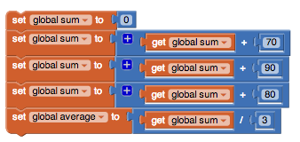
Sequence
Sequencing is the application of each step of the algorithm in the order in which the statements are given.
An App Inventor algorithm to compute the average of 70, 80, and 90.
Sequence Flowchart – the boxes
are individual steps.
Notes:
*

Slide 26
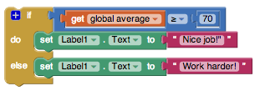
Selection
Selection uses a boolean (true, false) condition to decide which part of the algorithm to use.
False
True
An App Inventor algorithm to decide whether the average is a passing grade.
else:
do:
Selection flowchart -- the diamond is the condition; the circle is a connector.
Notes:
*

Slide 27
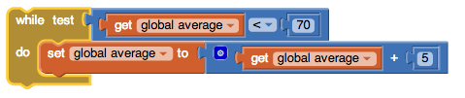
Repetition
Repetition (also called iteration) is the repeating of a part of the algorithm for a specified number of times or until a condition is met.
An algorithm to keep adding 5 points
to the average until it gets higher than 70.
do:
while
test
True
False
Repetition
(Looping)
Notes:
*

Slide 28
Expressing Algorithms
Algorithms can be expressed in many languages:
English,
English
If the average is 70 or better then set the label to “Nice job!”; otherwise set it to “Work harder!”
Notes:
*

Slide 29
Expressing Algorithms
Algorithms can be expressed in many languages:
English, pseudocode,
English
Pseudocode – less formal than a programming
language but more precise than English.
if average >= 70:
Set Label1.Text to “Nice job!”
else:
Set Label1.Text to “Work harder!”
If the average is 70 or better then set the label to “Nice job!”; otherwise set it to “Work harder!”
Notes:
*

Slide 30
Expressing Algorithms
Algorithms can be expressed in many languages:
English, pseudocode, App Inventor.
English
Pseudocode – less formal than a programming
language but more precise than English.
if average >= 70:
Set Label1.Text to “Nice job!”
else:
Set Label1.Text to “Work harder!”
If the average is 70 or better then set the label to “Nice job!”; otherwise set it to “Work harder!”
App Inventor
Notes:
*

Slide 31
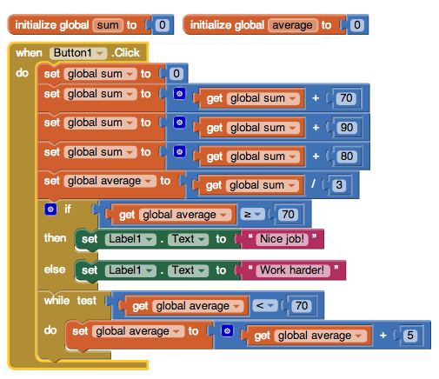
Executing Algorithms
Algorithms expressed in a programming language can be run on a computer.
Notes:
*

Slide 32
Important Facts About Algorithms
Notes:
*

Slide 33
Important Facts About Algorithms
An algorithm is like a recipe but has to be more precise than most recipes.
Notes:
*

Slide 34
Important Facts About Algorithms
An algorithm is like a recipe but has to be more precise than most recipes.
An algorithm is a step-by-step procedure to perform some calculation.
Notes:
*

Slide 35
Important Facts About Algorithms
An algorithm is like a recipe but has to be more precise than most recipes.
An algorithm is a step-by-step procedure to perform some calculation.
Each step of an algorithm must be precise and doable.
Notes:
*

Slide 36
Important Facts About Algorithms
An algorithm is like a recipe but has to be more precise than most recipes.
An algorithm is a step-by-step procedure to perform some calculation.
Each step of an algorithm must be precise and doable.
Every algorithm can be constructed by using just sequence, selection, and repetition.
Notes:
*

Slide 37
Important Facts About Algorithms
An algorithm is like a recipe but has to be more precise than most recipes.
An algorithm is a step-by-step procedure to perform some calculation.
Each step of an algorithm must be precise and doable.
Every algorithm can be constructed by using just sequence, selection, and repetition.
Algorithms can be expressed in flowcharts, pseudocode, and many programming languages.
Notes:
*

